Slide 1

Domain: MATLAB
Technology: COMMUNICATION
Development of a New Biometric Authentication
Approach Based on Electrocardiogram Signals

Slide 2
Index
Abstract
Introduction
Literature review
Existing Method
Disadvantages
Proposed method
Advantages
Applications
Hardware and Software Requirements
Results
Conclusion
References

Slide 3
Abstract
Biometrics is one of the greatest ways to authenticate people, according to recent research. This study proposes the electrocardiograph (ECG), a biometric that measures heartbeat. The ECGs are distinctive, hence the heartbeat biometric was chosen. Given the extractions and classification methods for the cardiac biometric signal, the goal of this study is to determine the best biometric features that can be used to identify a certain person. Based on a literature review, we presented a new, more effective method for extracting features from the ECG signal that uses these features as inputs for pattern recognition classifiers. This method is based on wave modelling of the ECG signal. The current approach involves a Median Filtering unlike the existing methods which removed at a greater extent, but not to the desired level, where the detection becomes more accurate. This suggested methodology has been tested on actual experimental ECG data. In order to process ECG signals, the most well-known and versatile MATLAB software must be used for signal acquisition, signal filtering, and pre-processing. When compared to features generated from traditional parameters, the results are quite accurate. In order to achieve the best classification results, wave modelling for feature extraction is the most effective and accurate method. In terms of future work, real-time applications that identify people require automatic heartbeat categorization.

Slide 4
Introduction:
Today, life engages technology in multiple ways, thus authentication in human technologies is very important. Secure and reliable authentication is in high demand. However, traditional methods for authentication such as face recognition, voice recognition and passwords are now outdated because faces are available in social media and couldn’t differentiate between two twins, and voices can be easily recorded from calls. However, ECG signal is a universal characteristic [1]. The Electrocardiogram (ECG) is the recording of electrical activity of human heart using electrodes placed on the skin over a period of time. The shape of the waveform reveals the current state of the heart and it offers helpful information regarding the rhythm and function of the heart. There are 3 main components to an ECG: P wave, QRS complex and T wave [2]. Recently, the possibility of using this ECG signal as a biometric tool has been suggested because the composition and activity of the human heart is unique, stable, easy to collect, have a high performance and it’s socially accepted. Its validity is well supported by the fact that both the physiological and geometrical differences of the heart under different subjects reveal certain uniqueness in the signal characteristics due to existing differences in morphology among individuals

Slide 5
Literature review:
S. NO | Journal Type with year | Authors | Title | Outcomes
1 | Volume 115, 2017, Pages 296-306 | Ala Abdulhakim Alariki, Sayed Mahmoud Alavy, Mohammad Reza Yousufi, Mohammad Tareq Aziz and Christine Murray, | A Review Study of Heartbeat Biometric Authentication | Studied about the A Review Study of Heartbeat Biometric Authentication
2 | Volume 115, 2017, Pages 296-306 | Kiran KumarPatro and P. RajeshKuma | Feature Extraction of ECG for Biometric Application, Procedia Computer Science | Studied about Feature Extraction of ECG for Biometric Application
3 | 2278-9359 (Volume-4, Issue-5) | Gaganpreet Kaur, Dr. Dheerendra Singh and Simranjeet Kaur | Electrocardiogram (ECG) as a Biometric Characteristic | Studied about Electrocardiogram (ECG) as a Biometric Characteristic
4 | 978-1-4673- 6911-415,2015 | Rupert Faltermeier, Ingo R. Keck, Ana Maria Tomé and Carlos G. Puntonet | Empirical Mode Decomposition - An Introduction | Studied about the EMD
5 | 978-1-4673- 6911-415,2015 | Shweta H. Jambukia, Vipul K. Dabhi and Harshadkumar B. Prajapat | Classification of ECG signals using Machine Learning Techniques a Survey | Studied about Classification of the ECG

Slide 6
Existing methods:
DATA PRE-PROCESSING ECG : Data collected usually contain noise. Due to presence of noise the feature extraction and classification becomes less accurate. To prevent misclassification, the ECG data must be processed. The first step must be to identify the noisy sources [3]. In this research, a cascaded digital filters configuration (empirical mode decomposition, low pass filter, high pass filter and derivative base filter), as shown in figure 1, is used for removal of three major noise of baseline drift, power line interference and EMG noise.

Slide 7
EMD is a decomposition technique that allows to represent a signal through the sum of functions derived from the latter, called Intrinsic Mode Function (IMF). The individual IMFs are obtained through a sifting operation. This is an iterative operation. The basic steps to achieve decomposition in IMF are: a. Identify local extremes. Especially, the maximum and minimum local values of the signal must be evaluated separately. b. Evaluate the upper and lower envelope of the signal through the application of a cubic spline EMD Low Pass Filter High Pass Filter Derivative Pass Filter 2019 Fifth International Conference on Advances in Biomedical Engineering (ICABME) 978-1-7281-2314-1/19/$31.00 ©2019 IEEE interpolation function of the data obtained in the previous point. c. Compute the mean envelope, obtaining m. Then subtract the mean from the input signal. d. Evaluate a term condition. If this is respected, then the difference between the input signal and m is the IMF and the next one is evaluated considering as a signal the difference between the input one and the IMF obtained. Otherwise, the process on the residual is repeated.

Slide 8
Disadvantages in Existing methods:
Noise sensitivity: ECG signals can be affected by various types of noise, such as electromagnetic interference or muscle activity, which can degrade the quality of the ECG signal. This can affect the accuracy and reliability of the biometric authentication system.
Vulnerability to spoofing attacks: Biometric authentication systems are vulnerable to spoofing attacks, where an attacker can use fake biometric data to impersonate the legitimate user
Cost: ECG-based biometric authentication systems can be expensive to implement, particularly for large-scale deployment

Slide 9
Proposed method:
DATA PRE-PROCESSING ECG : Data collected usually contain noise. Due to presence of noise the feature extraction and classification becomes less accurate. To prevent misclassification, the ECG data must be processed. The first step must be to identify the noisy sources [3]. In this research, a cascaded digital filters configuration (empirical mode decomposition, low pass filter, high pass filter and derivative base filter), as shown in figure 1, is used for removal of three major noise of baseline drift, power line interference and EMG noise.
Median filter
The median filter is a non-linear digital filtering technique, often used to remove noise from an image or signal. Such noise reduction is a typical pre-processing step to improve the results of later processing (for example, edge detection on an image). Median filtering is very widely used in digital image processing because, under certain conditions, it preserves edges while removing noise (but see the discussion below), also having applications in signal processing.

Slide 10
EMD is a decomposition technique that allows to represent a signal through the sum of functions derived from the latter, called Intrinsic Mode Function (IMF). The individual IMFs are obtained through a sifting operation. This is an iterative operation. The basic steps to achieve decomposition in IMF are: a. Identify local extremes. Especially, the maximum and minimum local values of the signal must be evaluated separately. b. Evaluate the upper and lower envelope of the signal through the application of a cubic spline EMD Low Pass Filter High Pass Filter Derivative Pass Filter 2019 Fifth International Conference on Advances in Biomedical Engineering (ICABME) 978-1-7281-2314-1/19/$31.00 ©2019 IEEE interpolation function of the data obtained in the previous point. c. Compute the mean envelope, obtaining m. Then subtract the mean from the input signal. d. Evaluate a term condition. If this is respected, then the difference between the input signal and m is the IMF and the next one is evaluated considering as a signal the difference between the input one and the IMF obtained. Otherwise, the process on the residual is repeated.

Slide 11
Advantages of Proposed method:
High accuracy than the previous method
Continuous authentication
Health monitoring
Cost-effective
Non-invasive

Slide 12
Applications:
1. Applied in DSP applications.
2. ECG Peak Detection.
3. Bio-Medical Signal Processing.
4. Image Processing.

Slide 13
Hardware and Software Requirements:
Hardware & Software Requirements:
Software: Matlab R2018a.
Hardware:
Operating Systems:
• Windows 10
• Windows 7 Service Pack 1
• Windows Server 2019
• Windows Server 2016
Processors:
Minimum: Any Intel or AMD x86-64 processor
Recommended: Any Intel or AMD x86-64 processor with four logical cores and AVX2 instruction set support
Disk:
Minimum: 2.9 GB of HDD space for MATLAB only, 5-8 GB for a typical installation
Recommended: An SSD is recommended a full installation of all Math Works products may take up to 29 GB of disk space
RAM:
Minimum: 4 GB
Recommended: 8 GB

Slide 14
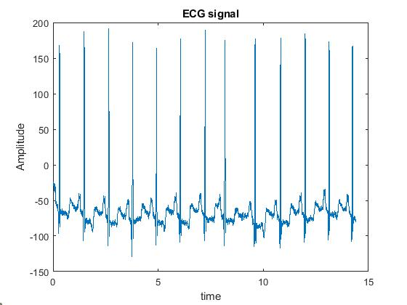
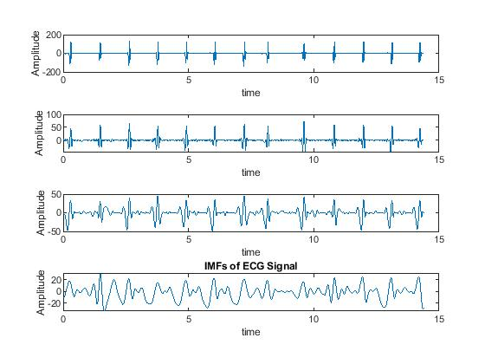
Results:

Slide 15
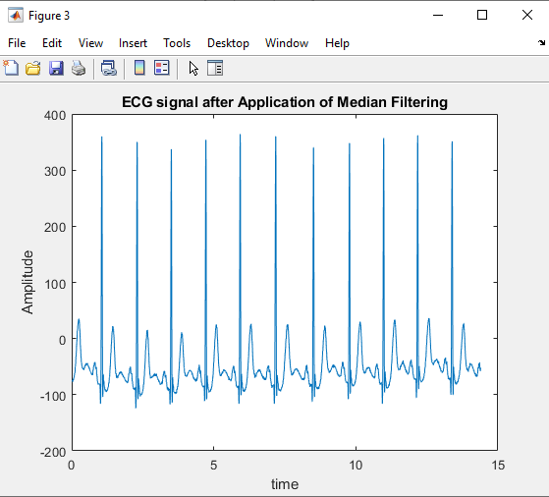
Results

Slide 16
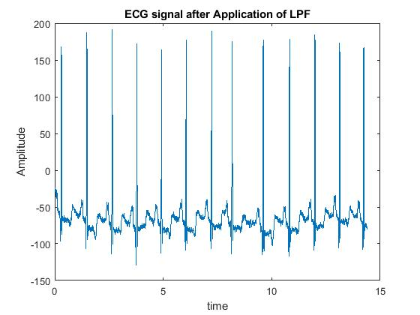
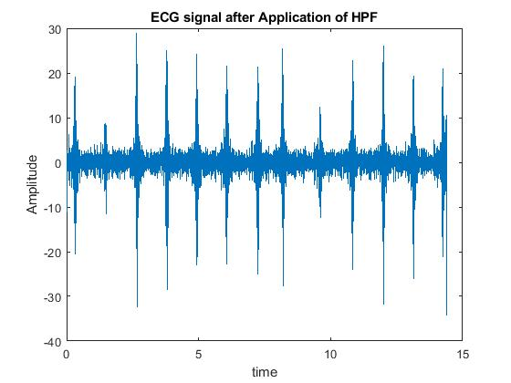
Results:

Slide 17
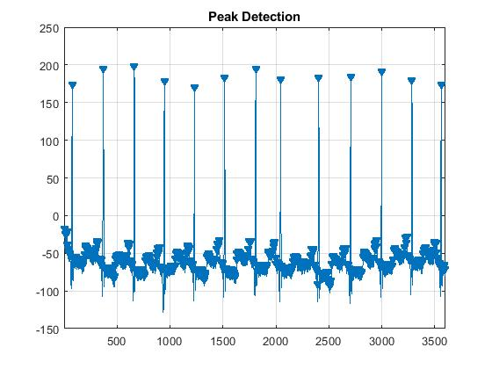
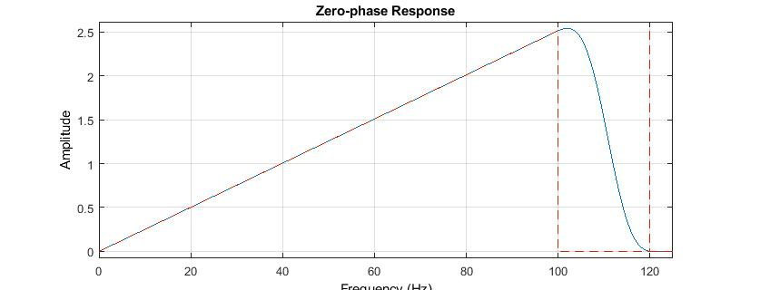
Results:

Slide 18
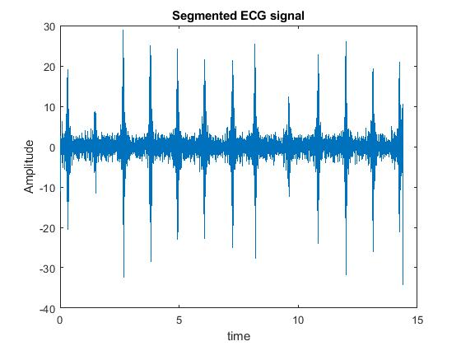
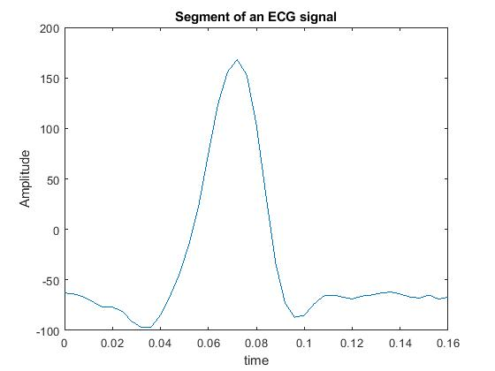
Results:

Slide 19
References:
[1] Ala Abdulhakim Alariki, Sayed Mahmoud Alavy, Mohammad Reza Yousufi, Mohammad Tareq Aziz and Christine Murray, A Review Study of Heartbeat Biometric Authentication, Volume 13, Number 8, August 2018
[2] Kiran KumarPatro and P. RajeshKumar, Effective Feature Extraction of ECG for Biometric Application, Procedia Computer Science, Volume 115, 2017, Pages 296-306
[3] Gaganpreet Kaur, Dr. Dheerendra Singh and Simranjeet Kaur, Electrocardiogram (ECG) as a Biometric Characteristic: A Review, International Journal of Emerging Research in Management &Technology ISSN: 2278-9359 (Volume-4, Issue-5)
[4] Rupert Faltermeier, Ingo R. Keck, Ana Maria Tomé and Carlos G. Puntonet, Empirical Mode Decomposition - An Introduction, July 2010, DOI: 10.1109/IJCNN.2010.5596829
[5] Shweta H. Jambukia, Vipul K. Dabhi and Harshadkumar B. Prajapati, Classification of ECG signals using Machine Learning Techniques a Survey, 978-1-4673- 6911-415,2015

